Slide 1
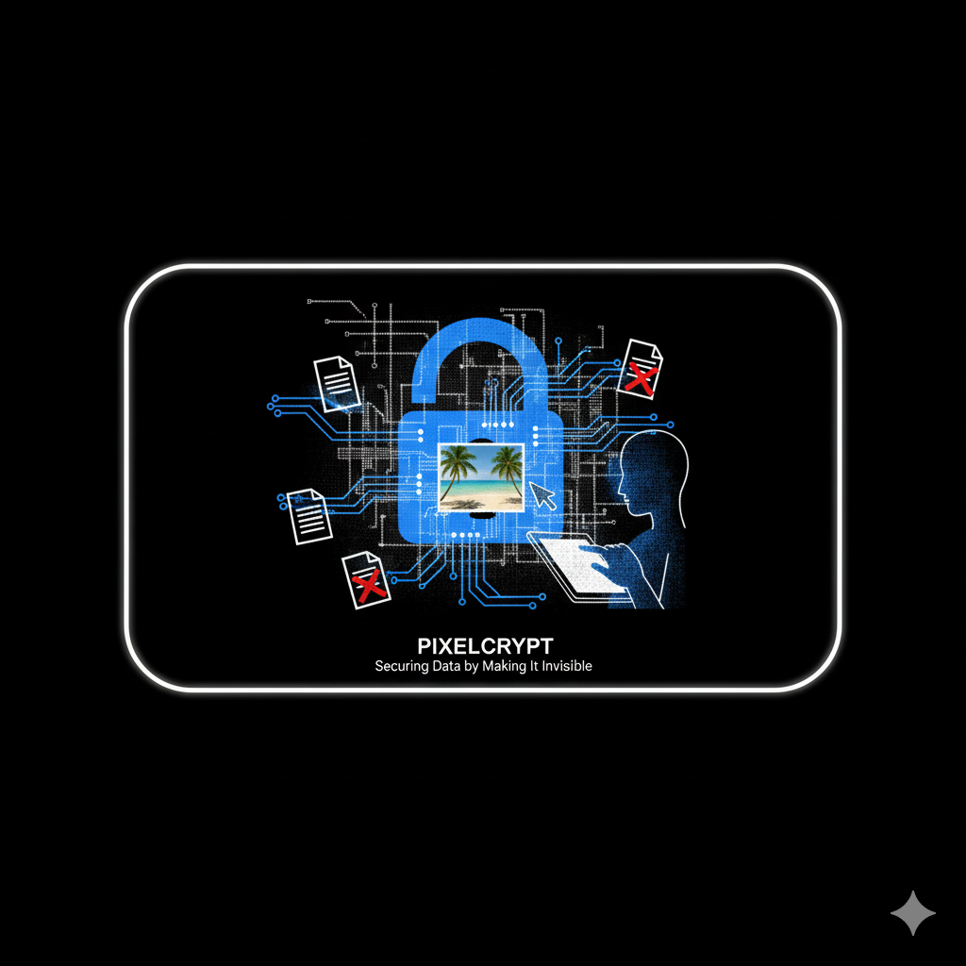
PIXELCRYPT
Securing Data by Making It Invisible
By Varun Kumar
USN : 1BI24MC157

Slide 2

WHY STANDARD ENCRYPTION ISN'T ENOUGH.?
  When you encrypt a file, you're essentially putting it in a digital vault. While the content is secure, the vault itself is obvious. An encrypted file screams, "I contain valuable, secret information!".
  This attracts unwanted attention from anyone monitoring your communications. The encrypted file itself becomes a target for analysis, theft, or demands for decryption.

Slide 3
LITERATURE SURVEY
Current steganography tools force users to choose between powerful but complex command-line utilities and convenient online tools that compromise privacy. This effectively locks secure data hiding away from everyday users, leaving a need for a tool that is both safe and simple. PixelCrypt bridges this divide by integrating strong AES encryption with clever LSB (Least Significant Bit) data hiding into an intuitive interface. It is a modern, offline application that finally makes truly secure and covert communication accessible to everyone.

Slide 4
COMBINING CRYPTOGRAPHY & STEGANOGRAPHY
Our Solution : PixelCrypt uses a two-layer approach for ultimate security.
  Cryptography (The Lock): We first scramble your secret message using a powerful encryption algorithm (AES). This makes the data unreadable without the password.
  Steganography (The Camouflage): Then, we take that scrambled message and hide it inside a normal, everyday file—like an image, video, or audio track. This is the art of data hiding.
To an outsider, there is no secret. There is only a regular file.

Slide 5
THE WORKFLOW: A TWO-STEP PROCESS
1. Encoding (Hiding the Message)
  A user provides their secret message and a password.
  The message is encrypted using the password.
  The encrypted data is then embedded into a "carrier" file (e.g., an image) using the Least Significant Bit (LSB) technique, which makes tiny, invisible changes to the file's data.
  The output is a normal-looking file that can be shared anywhere.

Slide 6
2. Decoding (Revealing the Message)
  The recipient loads the carrier file into PixelCrypt.
  They enter the correct password.
  The tool extracts the hidden data from the file.
  It then decrypts the data, revealing the original secret message.

Slide 7
MAIN FEATURES
  Multi-Format Support : Go beyond images to hide data in other files like audio (.wav) and video (.mp4), making the tool far more versatile.
  Capacity Calculator : Automatically analyse any file to instantly show the user the maximum amount of secret data it can hide without being detected.
  Decoy Secrets : Implement "plausible deniability" with a fake password that reveals a harmless decoy message, protecting your true secret even if you're forced to talk.
  Self Destruction : automatically all the hidden images along with the media will get deleted if the receiver not able to enter the correct password after three times.

Slide 8
APPLICATIONS
  Journalism & Activism: Bypassing surveillance and communicating safely in high-risk environments.
  Intellectual Property Protection: Embedding invisible watermarks to prove ownership of digital art or securing corporate trade secrets.
  An R&D team needs to send a secret design or formula to another company.They want extra security so no one can steal or spy on their information while sharing it.
  Personal Data Security: Creating hidden digital vaults for passwords, recovery keys, and private notes within personal photos stored in the cloud.

Slide 9
TECHNOLOGY & TOOLS
PixelCrypt is built using powerful and accessible open-source technologies, making it a robust and practical tool.
  Programming Language: Python – versatile and rich in libraries.
  Backend Framework: Flask – lightweight API framework for backend logic.
  Cryptography: Cryptography (Fernet / AES) – for secure message encryption.
  Steganography: Pillow (Image), Wave (Audio), OpenCV + FFmpeg (Video) – for LSB-based data hiding.
  Frontend (UI): React.js – fast, responsive, and modern user interface.

Slide 10

THANK
YOU

Slide 11
PIXELCRYPT
REVIEW-2
By Varun Kumar
USN : 1BI24MC157

Slide 12
METHODOLOGY :
- CHOSEN SDLC MODEL: AGILE MODEL
- REASON FOR CHOOSING AGILE:
  pixelcrypt evolved with continuous testing across image, audio, and video formats.
  it allows for flexible iterations, making it easy to add new steganography modules.
- AGILE PHASES USED IN PIXELCRYPT:
  Requirement Analysis : Identify the goal – securely hide secret messages inside images, audio, or video files.
  Design : Define modular architecture for encoding, decoding, and file handling.
  Development : Implement encryption (AES-256) and steganography using Pillow (image), FFmpeg + OpenCV (video), and Wave (audio).
  Testing : Validate with various formats – .png, .jpg, .mp3, .wav, .mp4.
  Deployment : Deployed locally with Flask backend and simple web UI (React frontend).
  Review : Each iteration was internally validated through structured testing and quality checks to ensure robust performance across image, audio, and video modules along with the security.

Slide 13
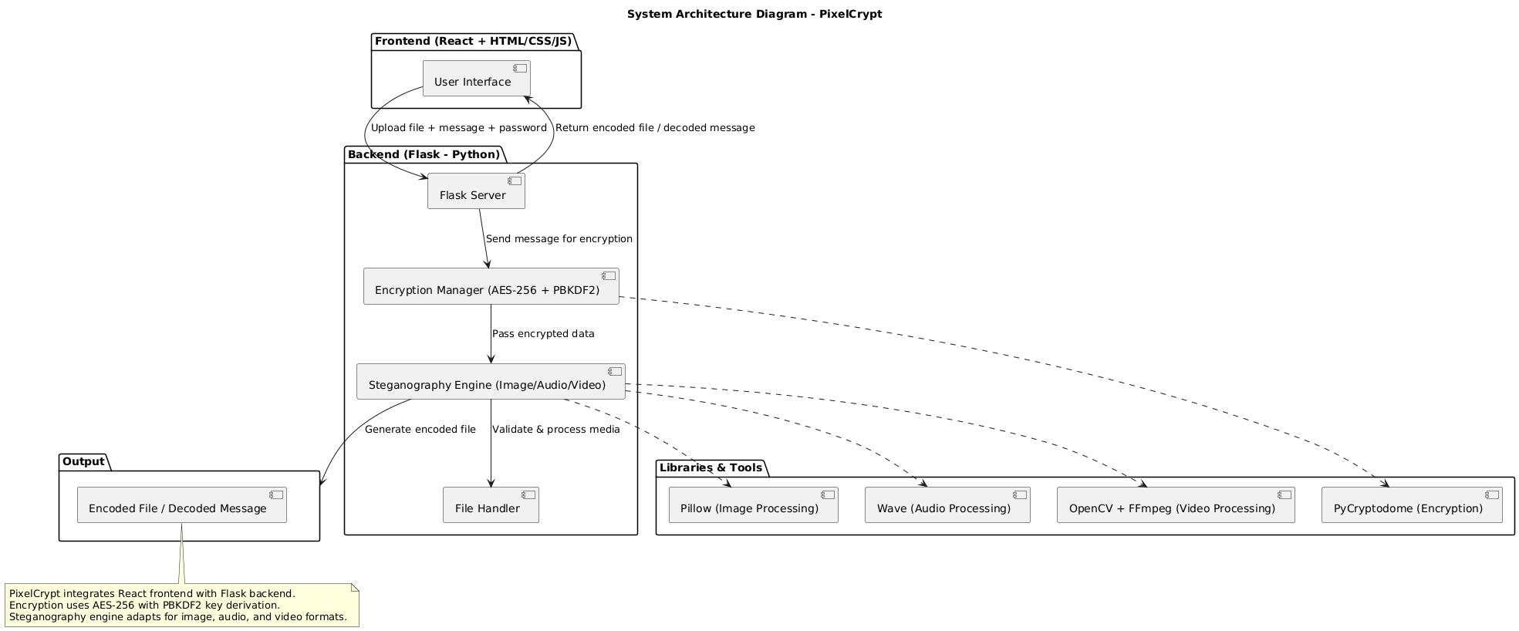
SYSTEM ARCHITECTURE :

Slide 14
SYSTEM DESIGN – 0-LEVEL DFD
ENTITIES:
  User: Uploads image/audio/video and secret message + password.
  PixelCrypt System: Performs encryption + embedding.
  Output: Encrypted file (image, audio, or video) containing hidden message.
  Receiver: Uploads that file → chooses “Decode” → enters password → retrieves hidden text.
FLOW:
  User uploads file and enters secret message.
  System encrypts message (AES-256).
  Embeds encrypted data into carrier (image/audio/video).
  Outputs encrypted media file.
  Receiver uploads encrypted file and enters password → decrypted message appears if password matches.

Slide 15
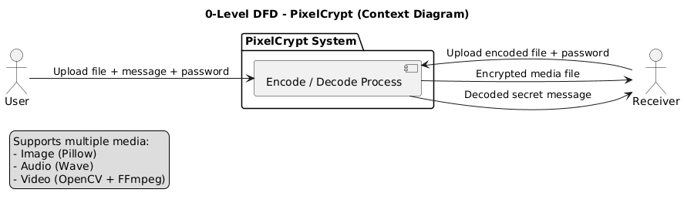
SYSTEM DESIGN – 0-LEVEL DFD

Slide 16
SYSTEM DESIGN – 1-LEVEL DFD
DETAILED PROCESS:
1. Input Validation:
  Checks file type (image/audio/video).
  Validates message length and suggests max length based on carrier size.
2. Encryption Module:
  Encrypts message using AES-256 algorithm.
  Derives encryption key from password using PBKDF2 + salt (for military-grade protection).
3. Steganography Engine:
  Embeds encrypted data:
- Images: via Pillow (LSB pixel manipulation)
- Audio: via Wave library (altering sample bits)
- Video: via FFmpeg + OpenCV (frame-level embedding)
4. Output Generation:
  Produces encoded file (same format as original).
5. Decoder Module:
  Extracts encrypted data and decrypts message using password.

Slide 17
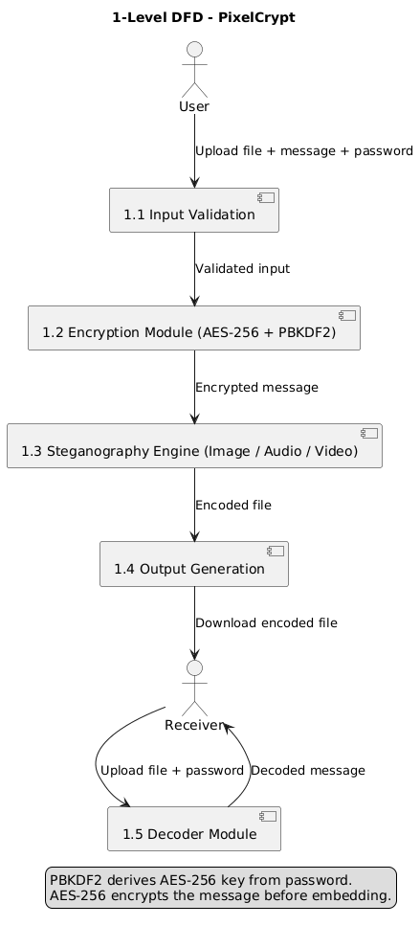

Slide 18
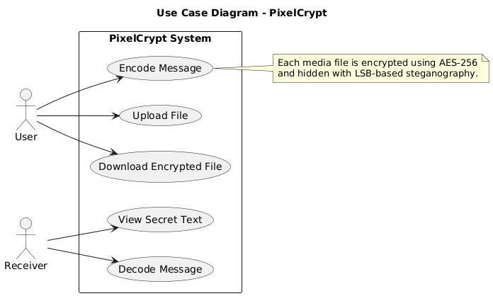
USE CASE DIAGRAM:
Actors: User, Receiver
Use Cases: Upload File, Encode Message, Download File, Decode Message, View Secret Text

Slide 19
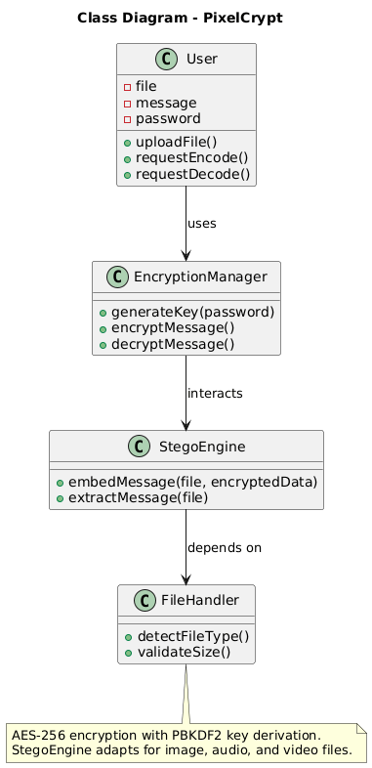
CLASS DIAGRAM :
  Classes: User, EncryptionManager, StegoEngine, FileHandler
  Key Methods:
  User: uploadFile(), requestEncode(), requestDecode()
  EncryptionManager: encryptMessage(), decryptMessage()
  StegoEngine: embedMessage(), extractMessage()

Slide 20
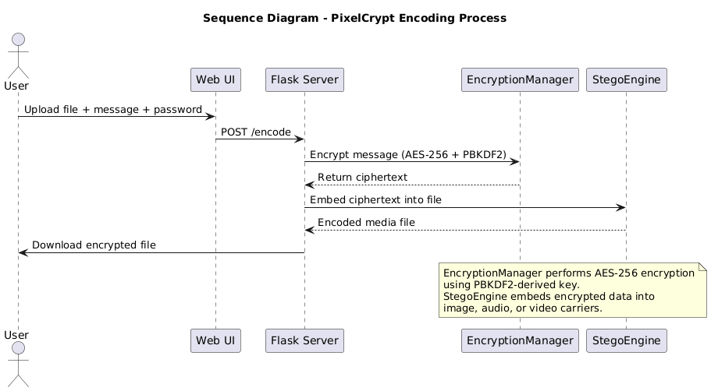
SEQUENCE DIAGRAM – ENCODING FLOW
  User uploads file + message + password
  Flask server calls EncryptionManager (AES-256 + PBKDF2)
  Ciphertext sent to StegoEngine → embedded in media
  Encoded file returned to user

Slide 21
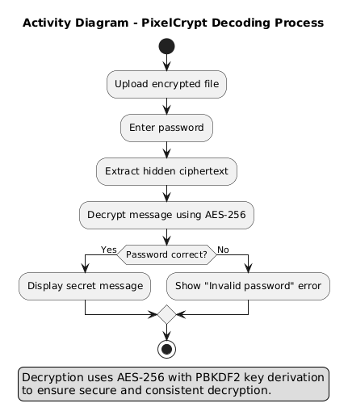
ACTIVITY DIAGRAM – DECODING FLOW
  Upload encoded file
  Enter password
  Extract ciphertext
  Decrypt using AES-256
  If password correct → show secret message else error

